Slide 1

WATERFALL MODEL
GROUP 1

Slide 2
GROUP MEMBERS
DAVIDA DZATO - CSC/19/01/4250
ALFRED KRAMPAH –CSC/19/01/8178
SENYO ADRAZKU - CSC/19/01/1250
RICHMOND ADJENYO –CSC/19/01/1240
ANTONIO YEBOAH –CSC/19/01/1323
JERRY DUHAZI -CSC/19/01/3444

Slide 3
TOPICS
Introduction
Definition
How it works
Advantages and Disadvantages
Applications

Slide 4

INTRODUCTION

Slide 5

INTRODUCTION
Waterfall model was the earliest SDLC approach that was used in software development
The development of the classic waterfall model is attributed to the computer scientist *WINSTON W. ROYCE*

Slide 6
DEFINITION

Slide 7
What is Waterfall model
Waterfall model deals with the SDLC that would function one after the another
In this model each phase must be completed before the next phase can continue
It is also known as a LINEAR -SEQUENTIAL LIFE CYCLE MODEL

Slide 8
HOW IT WORKS

Slide 9
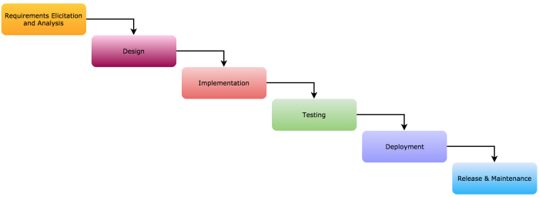
DIAGRAM FOR THE PHASES OF WATERFALL MODEL

Slide 10
PHASES OF WATERFALL MODEL
1. Requirement analysis
2. System design
3. Implementation
4. Testing
5. Deployment
6. Maintenance
NB:The outcome of any phase moves to the next stage/phase to be applied

Slide 11
HOW THE PHASES WORK HAND IN HAND
REQUIREMENT ANALYSIS
SYSTEM DEISGN
It helps in specifying hardware and system specification requirements and helps in defining the overall system architecture
To be able to know what the system needs
Requirements that are to be developed are collected and documented in the requirement specification document
(the specifications and ideas that are given to the team)

Slide 12
HOW THE PHASES WORK HAND IN HAND
Implementation
TESTING
The system developed in small programs called unit
(implementing the program into small units)
Each unit is test for its functionality
Consist of software programming ,troubleshooting ,module ,unit testing
It is when the software is integrated into desired target environment
By delivering the beta versions to selected users (also known as Beta testers)
It would determine if the software meets the requirements that was given

Slide 13
HOW THE PHASES WORK HAND IN HAND
DEPLOYMENT
Maintenance
When the testing is done and has been finalized it is then moved to the customer environment or released in the market
As time goes in their might been issues regarding to the software .patches are released and better versions are also produced or released

Slide 14

ADVANTAGES AND DISADVANTAGES

Slide 15

ADVANTAGES
Development process are easy to follow
The model focuses on the documentation of the process steps
Easy to arrange task
Clear defined stages
Easy to manage

Slide 16
DISADVANTAGES
Cannot be used for complex projects
No working software is produced until later during the life cycle
Poor model for long and ongoing projects

Slide 17

APPLICATION OF WATERFALL MODEL

Slide 18
APPLICATION
Projects must be short
Requirements must be well documented clear and fixed
Technology must be understood

Slide 19
AT LEAST TWO ITERATIONS
According to Royce, the waterfall model should be run at least twice
Ie:first for the development of a prototype and
then for the development of the actual software product.

Slide 20

THANK YOU

